Slide 1
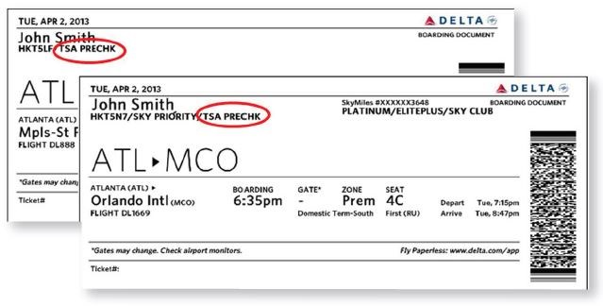
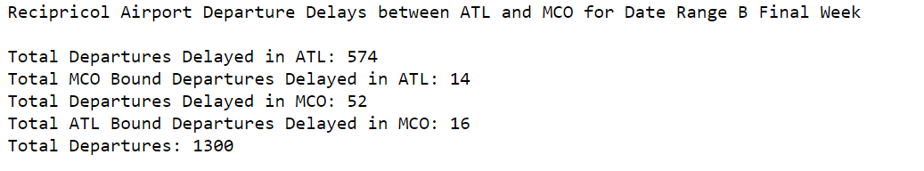
Findings and conclusions
AIRPORT TO AIRPORT IMPACT ANALYSIS
Q: What evidence is there that delays at one airport cause delays at another airport?
Based on the data we collected, we decided to examine any possible causality of delay from MCO to ATL and vice versa.
According to our data queries, only 4.8% (14+16) /( 574+52) of delayed flights out of ATL and MCO were bound for the other airport. This implies that on average, delays incurred at one airport do not incur significant delays at the other airports. But each airport has a different volume of airline flights originating from other airports (both domestic and international).
While Atlanta only received a comparative 2.8% of its delayed flights from MCO, Orlando received a comparative 27% of its delayed flights from ATL. So what does the data reveal for each airport?

Slide 2
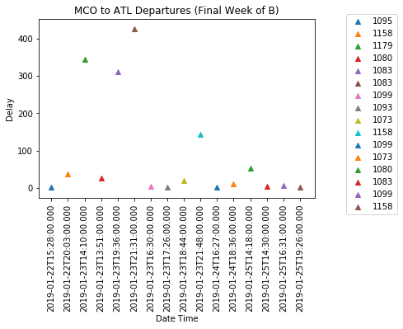
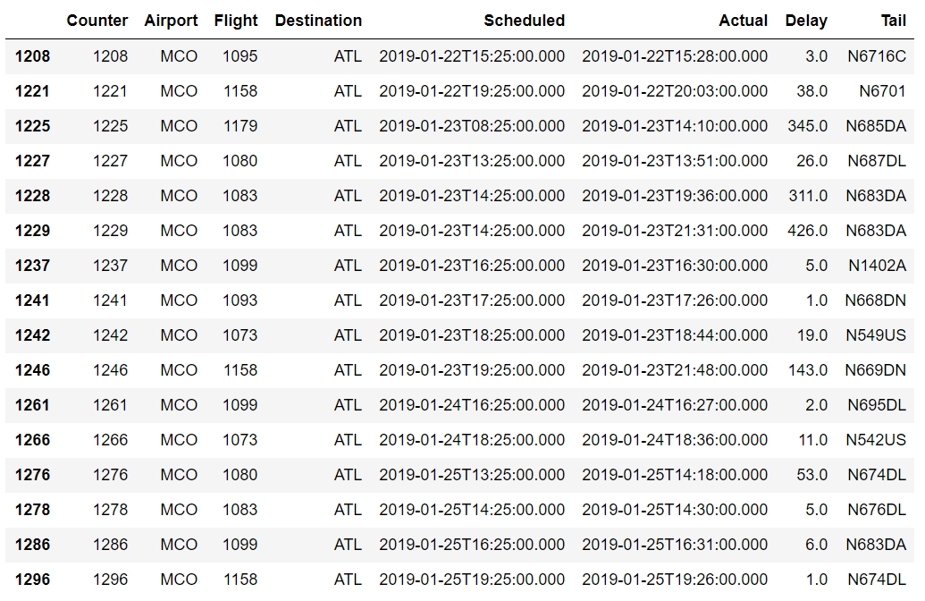
Findings and conclusions
ORLANDO AIRPORT: The most significant ATL bound flight delays occurred on January 23rd where all but two of the eight delayed flights greatly exceeded mean delay durations of 12 (Range B) and 17 minutes (Range B Final Week).
JUPYTER
Flight 1083 / N683DA appeared to have particular difficulties with accumulative delays.

Slide 3
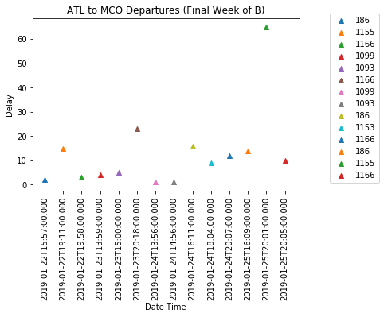
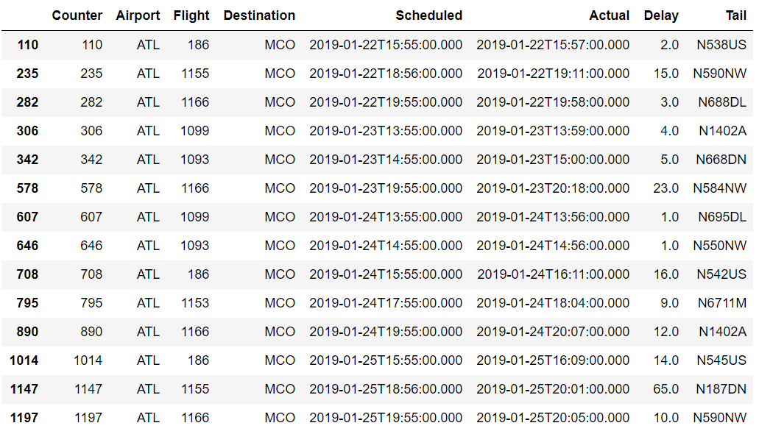
Findings and conclusions
ATLANTA AIRPORT: Considering ATL is a major hub (particularly for Delta Airlines), the mean delay for MCO bound aircraft is less than 15 minutes, which almost all fall within typical delay durations. While the 65 minute delay is outside our 8pm limit.
Based on the unique tail numbers, it appears that Delta utilizes a reserve of aircraft at ATL to operationally optimize for earliest possible departures.
JUPYTER

Slide 4
Summary
Watch Out! Data Analysts Beware! – Some API vendors charge by transaction (10 cents per flight)
Government shutdown effects on airports and airlines is gradual. There was no significant disruption to the number of flights or passengers, and delay durations in the first week of shutdown was comparable to the non government shutdown period.
Delta Airlines appears to be able to operationally optimize aircraft at the Major Hub of Atlanta to reduce departures delay times. They are less dependent on specific aircraft making timely connections. But this does not imply that all passengers are always able to make their connections through Atlanta Airport.
Delayed flights bound for Atlanta from Orlando experience significantly larger delays compared with connections in Atlanta. This might be due to lower availability of air traffic controllers at MCO compared with ATL. It may also be due to the volume of passengers originating in Orlando, unable to board timely, due to extensive security checkpoint delays.
If the government elects to privatize air traffic controllers and airport security and customs officers, this might possibly alleviate some of the airport based flight delays. But there is insufficient data available to directly correlate all of these factors.
If I do need to travel during a government shutdown in the future, I would plan to book a morning flight from Orlando, with enough time to make an afternoon connection in Atlanta. I would be less concerned with my connection being delayed in Atlanta.

Slide 5
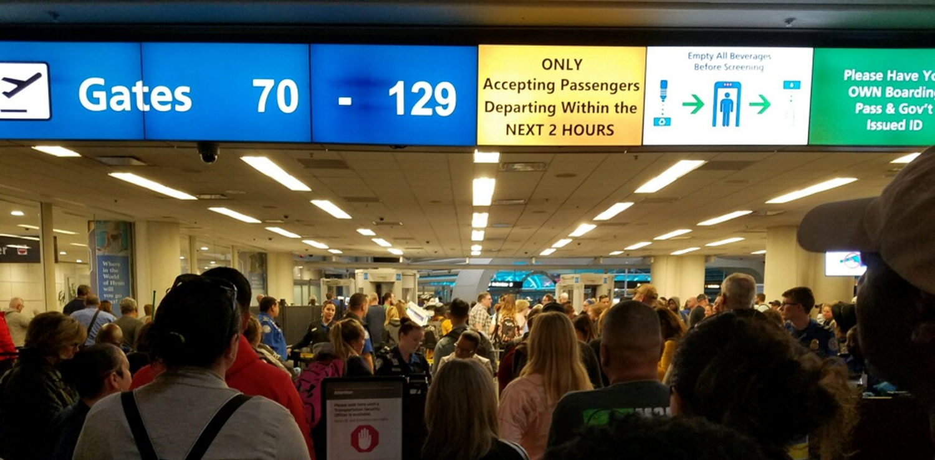
Enjoy Your Flight

